Slide 1
UNIT 4 What-if analysis & Data Validation

Slide 2
What-if analysis:
Goal Seeker
Scenario Manager
Data Table
Data Validation:
Need for Data Validation,
Creating a Validation List
Adding Custom Validation Error
Dynamic Formulas by using Validation Techniques

Slide 3
1. What-if analysis
A what-if analysis, as the name suggests, is a way to consider and react to future changes in a business plan. It creates a baseline financial model and allows a planner to manipulate variables to show how it changes the outcome.

Slide 4
1.1 Goal Seeker
Whenever you create a formula or function in Excel, you put various parts together to calculate a result.
Goal Seek works in the opposite way: It lets you start with the desired result, and it calculates the input value that will give you that result.
https://www.cubesoftware.com/blog/what-if-analysis#:~:text=The%20Goal%20Seek%20feature%20lets,If%20Analysis%2C%20then%20Goal%20Seek.
https://edu.gcfglobal.org/en/excel/whatif-analysis/1/

Slide 5
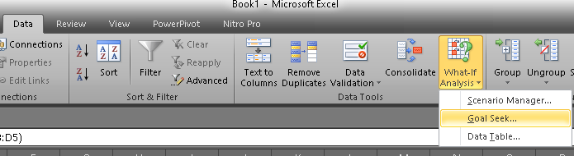
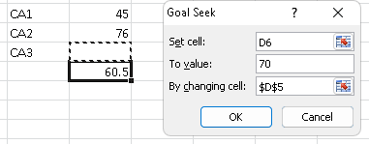
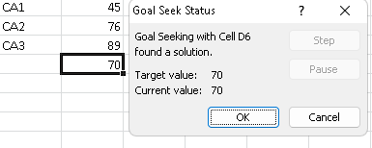
Goal Seeker

Slide 6
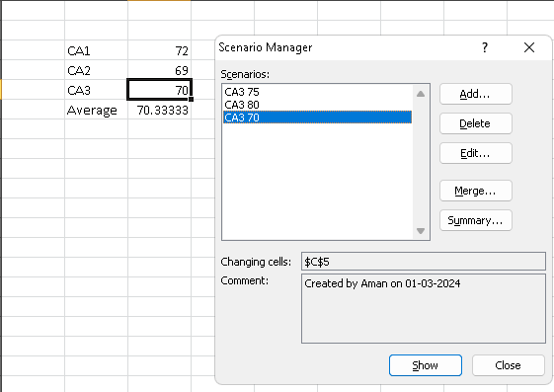
1.2 Scenario Manager

Slide 7
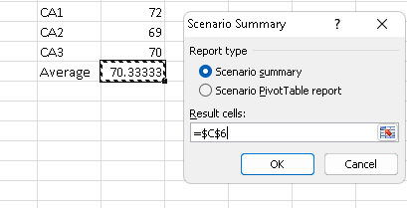
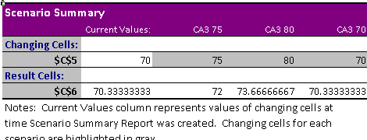
The what-if Scenario Analysis function can help you make decisions by showing the impact of changing one or more variables.

Slide 8
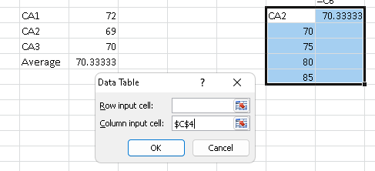
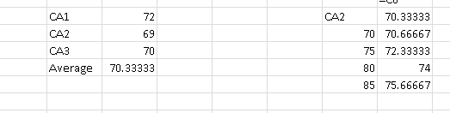
1.3 Data Table

Slide 9
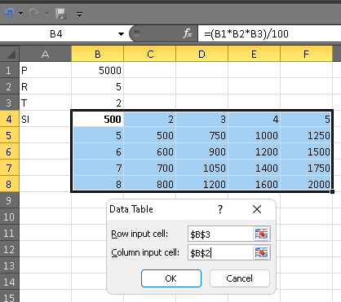
In Excel, a data table is a range of cells where you can change values to get different answers to a problem.

Slide 10
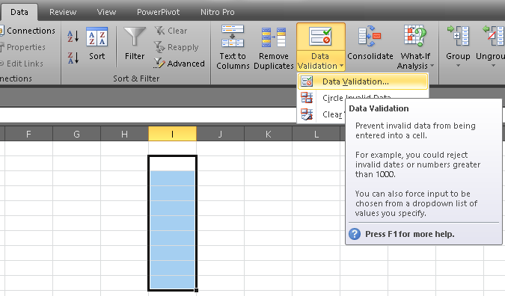
Data Validation
Data validation in Excel is a technique that restricts user input in a worksheet. It is often used to limit user entry.

Slide 11
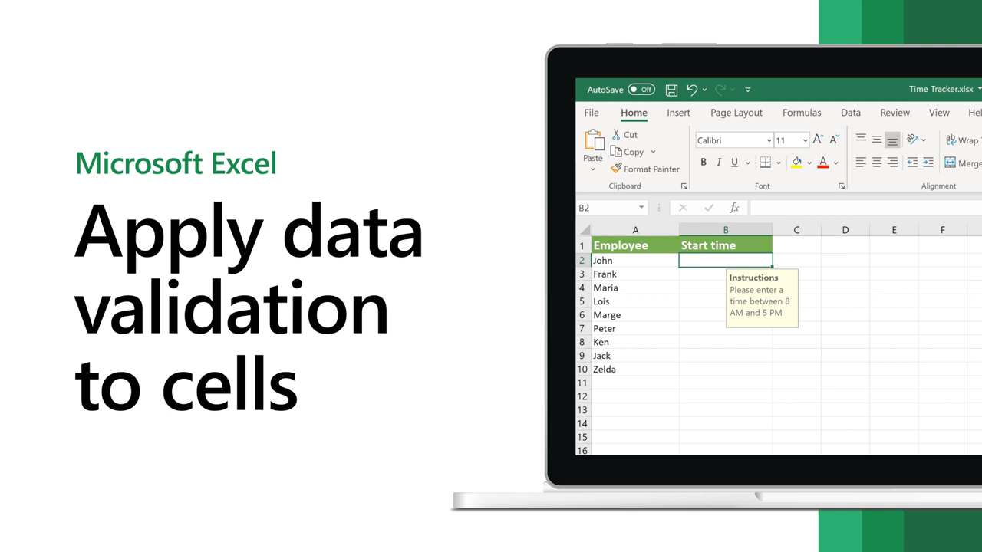
Notes:
https://www.youtube.com/watch?v=AZLUK9OAq2I

Slide 12
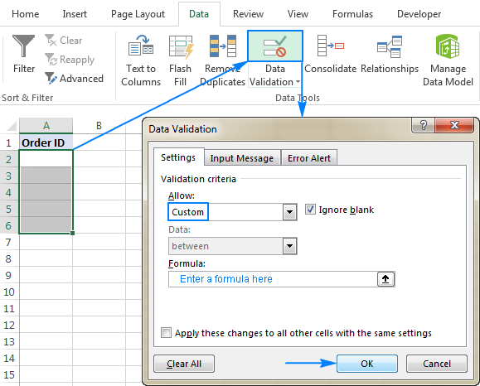
custom data validation

Slide 13
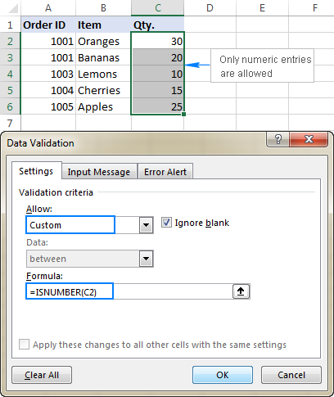
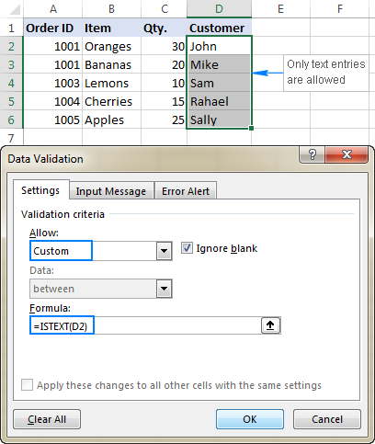

Slide 14
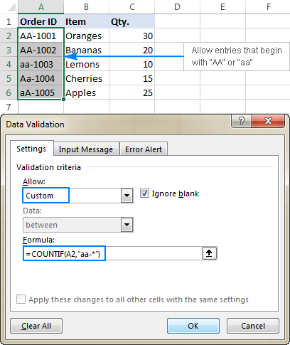
https://www.ablebits.com/office-addins-blog/excel-data-validation-custom-formula/#setup-custom-validation-rule

Slide 15
END

